Slide 1
Campus Area Network Design
Submitted by-
V.Harish Raghavendra - RA1911031010023
Amal Jogy- RA1911031010034
Ananya Trivedi - RA1911031010038

Slide 2
Introduction
Although the computer industry is still young compared to other industries (e.g., automobiles and airline industry), computers have made amazing progress in a (relatively) short time-frame. During the first 20 years of their existence, computer systems were extremely centralized, usually within one large room. Not infrequently, this room had glass walls, through which visitors could gaze and marvel at the electronic wonder inside. A medium-sized company or university (for example, Dartmouth) may have had one or two computers, while very large institutions (for example, the Smithsonian Museum) had at most a few dozen. The idea that within less than 35 years, vastly more powerful
computers smaller than the stamps used in postcards, would be mass produced by the billions was pure science fiction.
The merging of computers and communications has had a profound influence on the way computer systems are organized. The predominant concept of the “computer center” as a single room with a large computer to which users brought their work, which an operator fed into the computer, is now obsolete. The old model of a single computer serving all of the organization’s needs has been replaced by one in which a large number of separate, but still interconnected computers, do the job.
These systems are called computer networks. Two computers are said to be interconnected if they are able to exchange information. The connection need not be via a copper wire - fiber optics, microwaves, IR, and even satellites can be used (and are in use). They are usually connected together to make larger networks, with the Internet being the most well-known example of a network of networks.

Slide 3
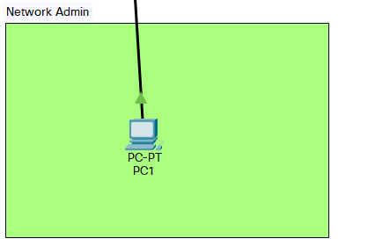
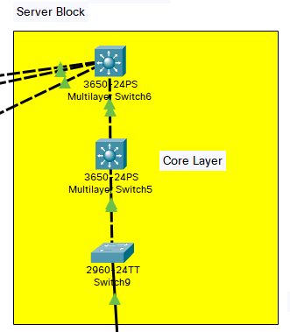
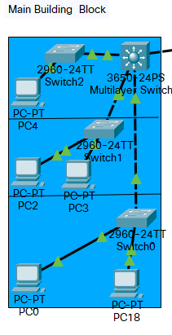
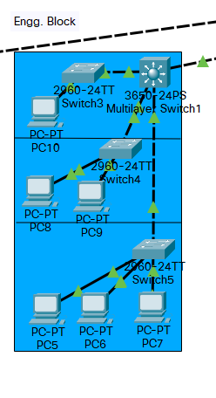
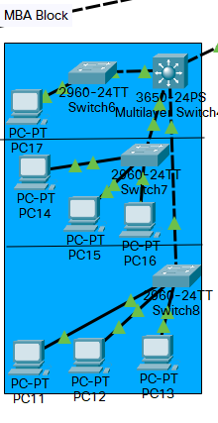
Design Architecture

Slide 4
Network Requirement Analysis
Switches – A switch is used for handling selective data units, termed as packets. For example, suppose a client from the Human Resources Department (say PC1) wants to send some confidential data to a client in the R&D Department (say PC9) – this is accomplished through a switch, since a router would forward the packets everywhere without rhyme or reason – hence breaking the confidentiality of the data.
Multilayer switch (MLS) - is a computer networking device that switches on OSI layer 2 like an ordinary network switch and provides extra functions on higher OSI layers. ... Switching uses different kinds of network switches. A standard switch is known as a layer 2 switch and is commonly found in nearly any LAN.
A personal computer (PC) - is a multi-purpose computer whose size, capabilities, and price make it feasible for individual use. Personal computers are intended to be operated directly by an end user, rather than by a computer expert or technician. Unlike large, costly minicomputers and mainframes, time-sharing, by many people at the same time, is not used with personal computers.
Coaxial cable - is a type of cable used to transmit data, the internet, video and voice communications.

Slide 5
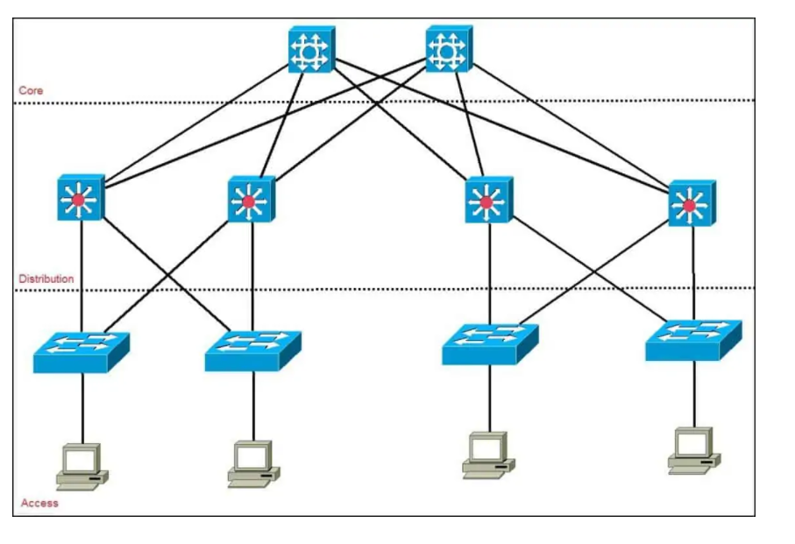
Network Architecture:- Cisco’s 3 Layer Architecture
Access – controls user and workgroup access to the resources on the network. This layer usually incorporates Layer 2 switches and access points that provide connectivity between workstations and servers. You can manage access control and policy, create separate collision domains, and implement port security at this layer.
Distribution – serves as the communication point between the access layer and the core. Its primary functions are to provide routing, filtering, and WAN access and to determine how packets can access the core.
Core – also referred to as the network backbone, this layer is responsible for transporting large amounts of traffic quickly

Slide 6
Network and system integration methodology
Main Building Block:- Networks being shared to the main building block in the 3 floors are separated using switches to ensure data separation, better security and reduced network load
Engineering Building Block:- Networks being shared to the engg. building block in the 3 floors are separated using switches to ensure data separation, better security and reduced network load
MBA Building Block:- Networks being shared to the MBA building block in the 3 floors are separated using switches to ensure data separation, better security and reduced network load
MBA Building Block:- Networks being hosted and shared in the Server Block is based on switches both single and multilayer for better sharing and easy access and utmost security
Network Access for user:- User can send and receive data to the predetermined target, User has the lowest level of access
Network Access for admin:- Admin has the highest access and control over the network and entire data traffic

Slide 7
IP NETWORK DESIGN GUIDELINES
VLAN
A virtual LAN is any broadcast domain that is partitioned and isolated in a computer network at the data link layer. LAN is the abbreviation for local area network and in this context virtual refers to a physical object recreated and altered by additional logic. We use that for better security and data management and reduced network traffic
Telnet
Telnet is an application protocol used on the Internet or local area network to provide a bidirectional interactive text-oriented communication facility using a virtual terminal connection, it also allows us to communicate between devices in clear manner
SSH
Secure Shell is a cryptographic network protocol for operating network services securely over an unsecured network. Typical applications include remote command-line, login, and remote command execution, but any network service can be secured with SSH
Trunk
VLAN Trunking Protocol is a Cisco proprietary protocol that propagates the definition of Virtual Local Area Networks on the whole local area network

Slide 8
Features and Services
Instant network access
We are not adding a portal for login – we felt it was too cumbersome. Instead, we used a simple plug and setup, connected to Access Layer.
Security
We have also enabled a selective example to showcase the security measures we could possibly undertake in the future, we have provided a password to all switches to access
Network Administrator
Shutdown or restart the entire network
Add more sub-networks to the main networks (example – adding more users to a VLAN, in case a new department is established),
Subnetting – although not done in our network due to complexity issues, it is possible for the network administrator(s) to establish subnetting in case of lack of IP addresses.
It is also possible for the routers to get their firmware replaced, updated, etc. by the network administrator(s).

Slide 9
Conclusion
We have created a simple, robust and effective and also highly scalable network architecture with all the necessary basic implementation and room for improvements and upgradation. We have designed and deployed a LAN based network since it’s the most common and can be easily connected to WAN or upgraded while following industry standard practices.

